Slide 1

C Program Presentation
------ Bricks Breaking

Slide 2


Group Members
Complete the functions of the interface and making a new model .
Complete the functions of the maps and doing the combination of the functions.
Complete the fuctions of the board and ball moving
Complete the functions of the tool of the game.

Slide 3
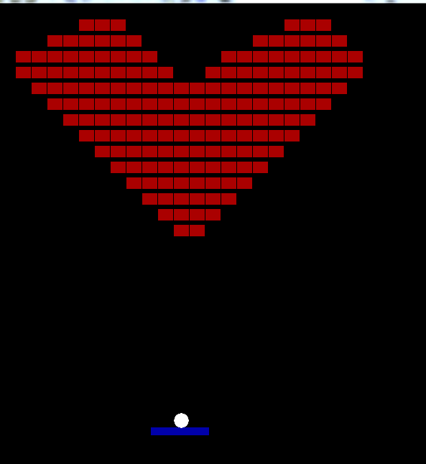
Introduction
Our C program is a game called bricks breaking.
In the game, the players can press “A” and “D” to control the broad moving to get the ball .
If the player can't get the ball, you will lose the game.
When the player breaks all the bricks,the game will be over.And you will win the game.
In addition,we created a new model that the player can make their own maps.

Slide 4
Analysis
Solutions’ constraints:
The player can only press “A” and “D”, the other buttons can't work.
If the player can't touch the ball or breaks all the bricks,the game will be over.
4
A function to make tools which can make the game more funny
3
A function to make the game over(When the player can't get the ball or break the bricks)
requirements
2
A function to make the board and the ball move.
1
A function to make maps which include bricks,broad and ball.

Slide 5
Design
start
Yes
Tool appearing
No
Creatmap()
Does break all bricks
No
can board get the tool
input:n
Yes
No
Yes
Game over
is n “A” or “D”
change
End
No
Yes
boardmove()
ballmove()
can board get the ball

Slide 6
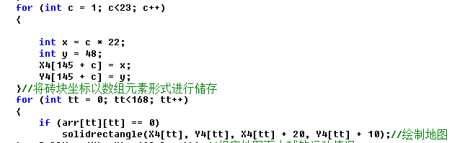
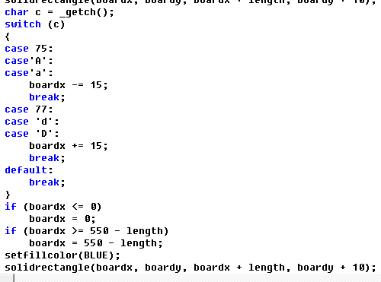
Implementation
code:
How to draw bricks
How do boards move

Slide 7
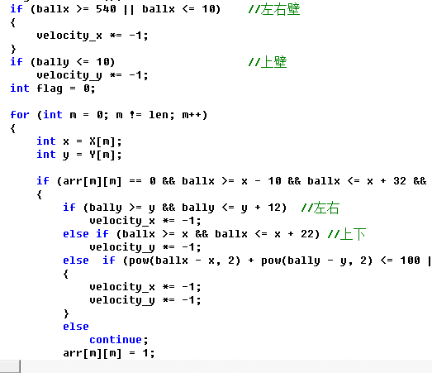
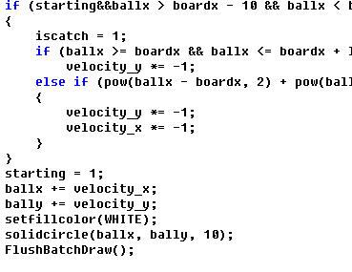
Implementation
code:
How does the ball move and how is the ball eliminated

Slide 8
Testing
boardmove
Input | the expected | real result
“A” | The abscissa of the board is reduced by 15
“D” | The abscissa of the board is increased by 15
“E” | No response
Making bricks
Input | the expected | real result
“3” ”4” | Bricks appear in the third row and the fourth column
“9” “0” | Bricks will not appear
“a” “b” | Bricks will not appear

Slide 9
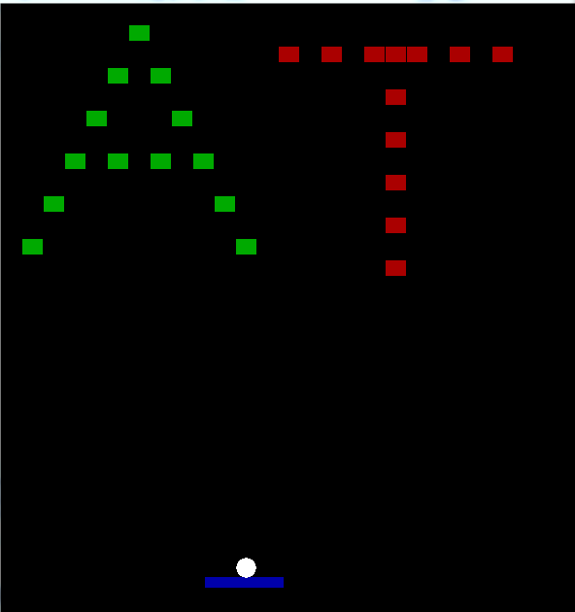
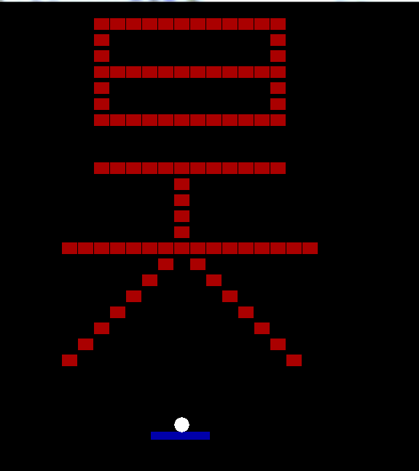
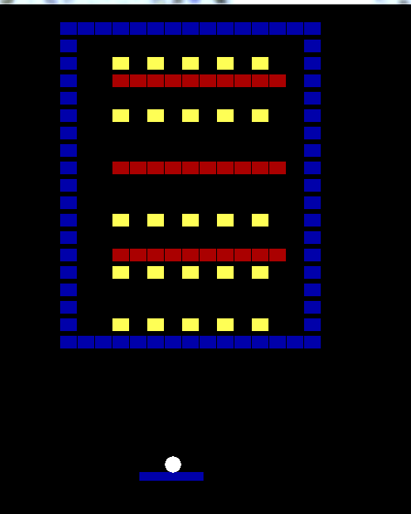
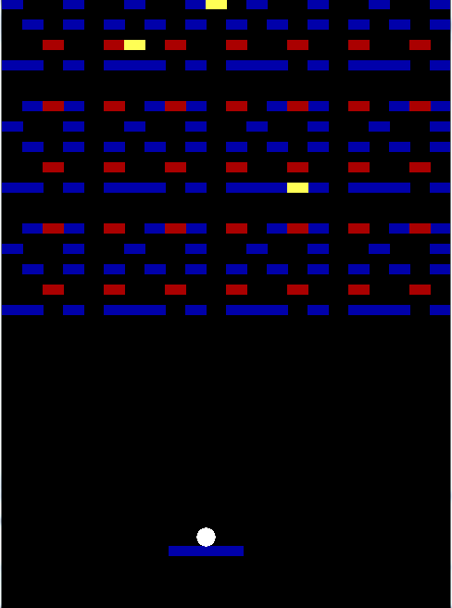
Result&Conclusion
In the end ,we have achieved this goal.We have created five maps for the players,so they can choose the map they like to begin the game.
If the player doesn't like the maps,we created a new model.
In this model,the player can make the map by their own and use the map made by themseveles to strat the game.
Next is our C program presention

Slide 10


PPT模板下载：www.1ppt.com/moban/ 行业PPT模板：www.1ppt.com/hangye/
节日PPT模板：www.1ppt.com/jieri/ PPT素材下载：www.1ppt.com/sucai/
PPT背景图片：www.1ppt.com/beijing/ PPT图表下载：www.1ppt.com/tubiao/
优秀PPT下载：www.1ppt.com/xiazai/ PPT教程： www.1ppt.com/powerpoint/
Word教程： www.1ppt.com/word/ Excel教程：www.1ppt.com/excel/
资料下载：www.1ppt.com/ziliao/ PPT课件下载：www.1ppt.com/kejian/
范文下载：www.1ppt.com/fanwen/ 试卷下载：www.1ppt.com/shiti/
教案下载：www.1ppt.com/jiaoan/ PPT论坛：www.1ppt.cn

